Slide 1

Git. Genau wie Subversion nur anders

Slide 2

Subversion vs Git Windows Desktop Integration
Checkout
Commit
Add File(s)
Remove File(s)
Revert
Show Log
Differences

Slide 3


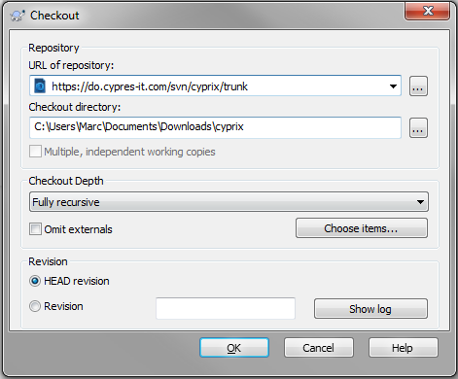
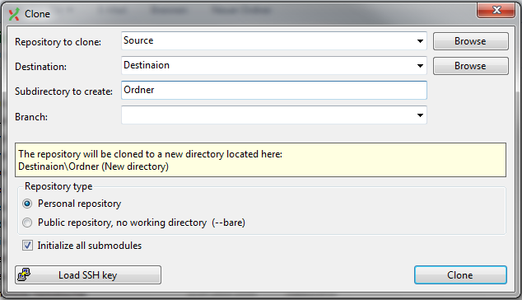
Checkout
Subversion
Git

Slide 4
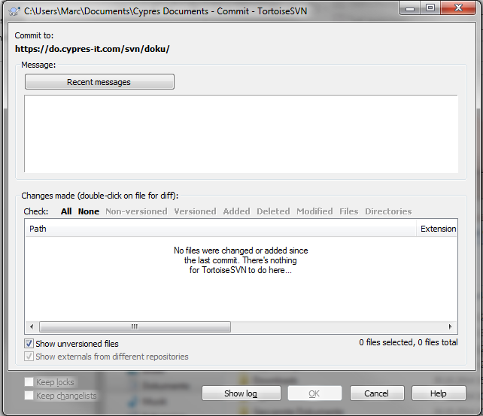
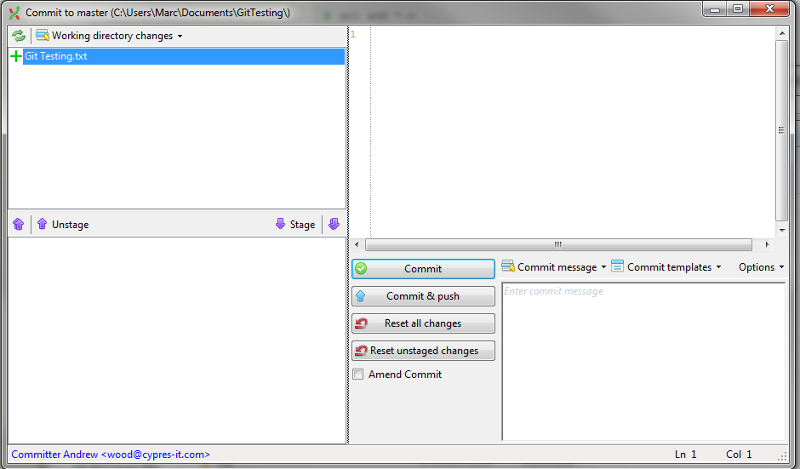
Commit
Subversion
Git

Slide 5

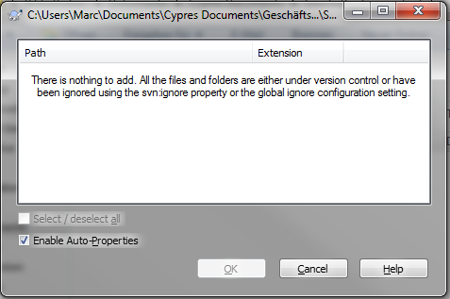
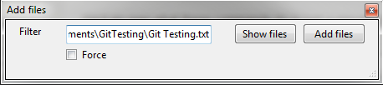
Add File(s)
Subversion
Git

Slide 6
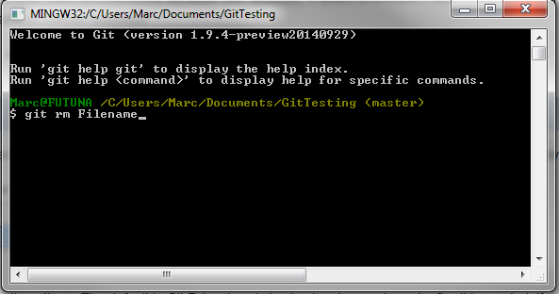
Remove File(s)
Subversion
Git
Can only be done from the command prompt

Slide 7
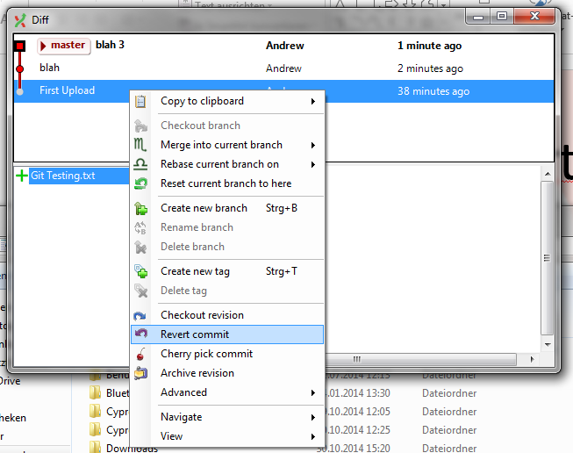
Revert
Subversion
Git

Slide 8
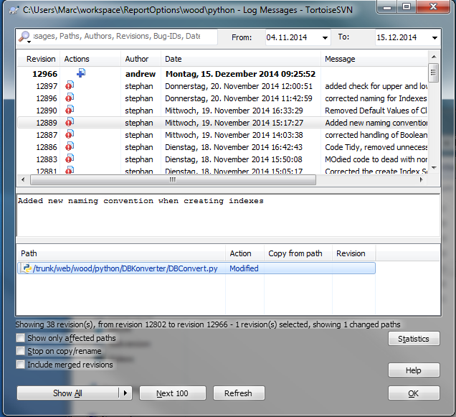
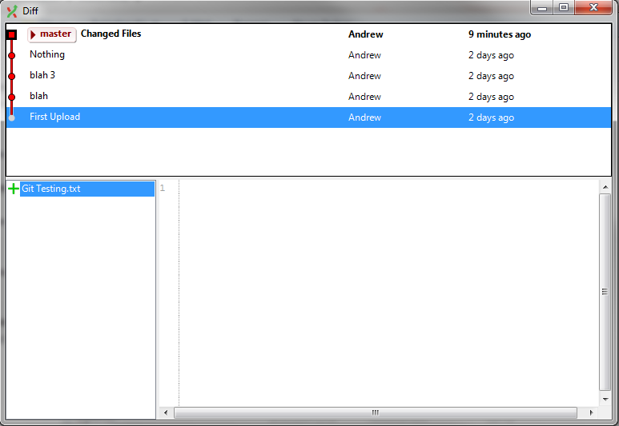
Show Log
Subversion
Git

Slide 9
Differences
Subversion
Git
Singe Repository
Minimum 1 Repository
Commit / Revert can be local
Push to another Repository
Pull from a Repository

